Slide 1

Technology Fundamentals
Course Introduction
SoftUni Team
Technical Trainers
Software University
https://softuni.bg/

Slide 2
Table of Contents
Course Objectives
Training and Team
Course Organization
Course Infrastructure
Evaluation Criteria

Slide 3
Have a Question?
sli.do
#fund-java

Slide 4











SoftUni Diamond Partners

Slide 5


Educational Partners

Slide 6

Course Objectives

Slide 7
Java Fundamentals Objectives
Working with linear data structures
Arrays and Lists
Defining simple classes
Processing and manipulating strings
Regular Expressions
Building simple web project

Slide 8
Practical Programming Exam
Mid Exam
3 practical problems for 4 hours
Conditional Statements and Loops
Linear Data Structures – Arrays and Lists
Final Exam
3 practical problems for 4 hours
Strings and Text Processing
Associative Arrays
Regular Expressions

Slide 9
Theoretical Exam
You will have 30 minutes once you enter
Multiple choice with only 1 correct answer
English
Automated quiz system
Available online on the day of the practical exam
You can submit your answers just one time

Slide 10

The Team

Slide 11
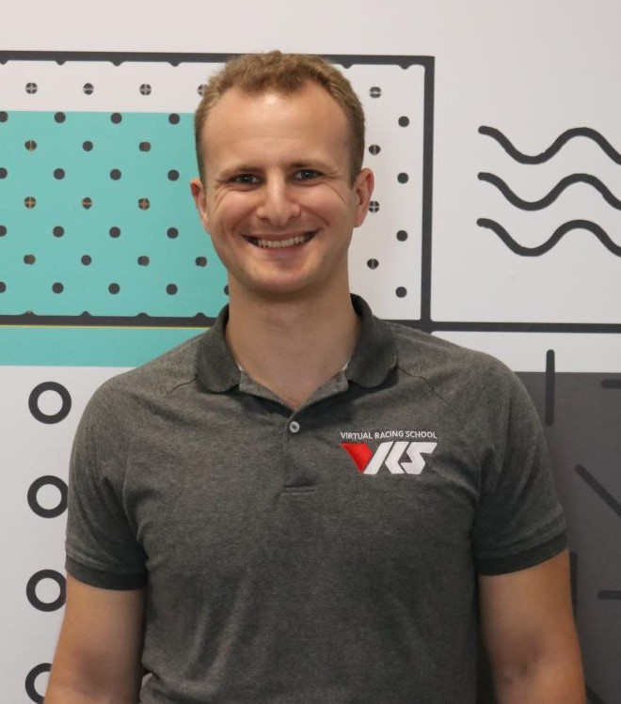
Georgi Georgiev
Technical trainer @ SoftUni
C++, C#, Java, Data Structures and others
Developer @ VirtualRacingSchool.com
Java, JavaScript, C++
Experience
4+ years training, 10+ years coding
Wrote a driving simulator once in high school (DriveFreeZ award)
Played around with OpenGL, Bullet Physics SDK, WinRT

Slide 12
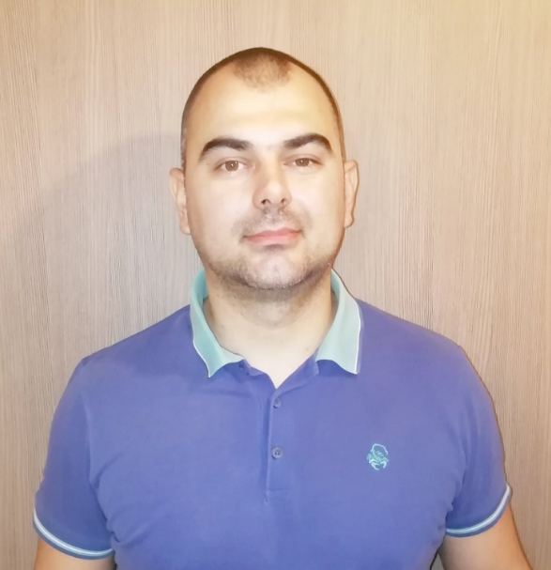
Kaloyan Kostadinov
Complete Java Education @SoftUni
Java Developer @ Playtech
Interests in C#, Java and JavaScript

Slide 13

Course Organization

Slide 14
Java Fundamentals Module
10-Jan-2022
20-Feb-2022
03-Apr-2022
07-Apr-2022
11-Apr-2022
Java Fundamentals
12 weeks * 3 times / week
12 credits
Start: 10-Jan-2022
Mid Exam: 20-Feb-2022
Theoretical exam: 03-Apr-2022
Final exam: 03-Apr-2022
Re-Take Exams
Mid Exam Retake: 07-Apr-2022
Theoretical Exam: 11-Apr-2022
Final Exam Retake: 11-Apr-2022

Slide 15
Course Scoring
Practice grade:
Theory grade:
SoftUni Certificate: 5.00 from Practice
CPE Certificate: 3.00 average from Practice + Theory
Practical Mid Exam
Practical Final Exam
Homework
40 %
60 %
+5 %
Theoretical Exam
100 %
15

Slide 16

Homework Assignments & Exercises
Your homework is mainly work in class
Lesson days → slides + live demos + exercises
Exercise days → only exercises
How to submit your homework?
Submitted in the judge system
Do your homework when it's due
Assignments pile up quickly

Slide 17



Course, Forum and FB Group
Official web site:
Official discussion forum:
Official Facebook group:
Community Facebook group:
https://softuni.bg/trainings/3448/programming-fundamentals-with-java-january-2022
softuni.bg/forum/categories/44/
https://www.facebook.com/groups/ProgrammingFundamentalswithJavaJanuary2022
https://www.facebook.com/groups/SoftUniJavaCommunity/

Slide 18
Questions?
Notes:
18

Slide 19
Trainings @ Software University (SoftUni)
Software University – High-Quality Education, Profession and Job for Software Developers
softuni.bg, about.softuni.bg
Software University Foundation
softuni.foundation
Software University @ Facebook
facebook.com/SoftwareUniversity
Software University Forums
forum.softuni.bg
Notes:
19

Slide 20

License
This course (slides, examples, demos, exercises, homework, documents, videos and other assets) is copyrighted content
Unauthorized copy, reproduction or use is illegal
© SoftUni – https://about.softuni.bg/
© Software University – https://softuni.bg
Notes:
20

